Slide 1
Visualization of scoliotic spine using ultrasound-accessible skeletal landmarks
Ben Church¹, Andras Lasso¹, Christopher Schlenger, Daniel P. Borschneck², Parvin Mousavi¹, Gabor Fichtinger^{1,2}, Tamas Ungi^{1,2}
Surgery, School of Computing, Queen’s University, Kingston, ON, Canada
Department of Surgery, Queen’s University, Kingston, ON, Canada

Slide 2
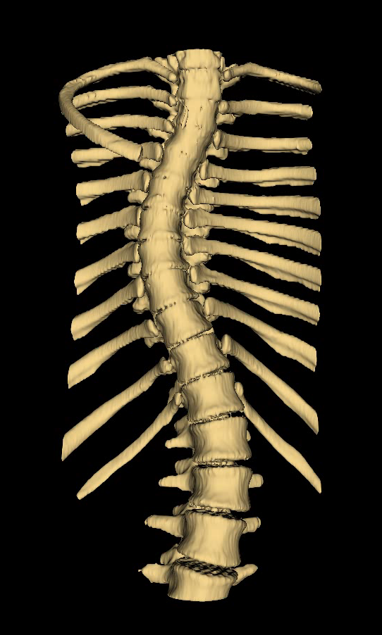
Introduction - Scoliosis
Scoliosis is lateral spinal curvature
Curvature progresses with growth
Regular assessment helps ensure early treatment

Slide 3
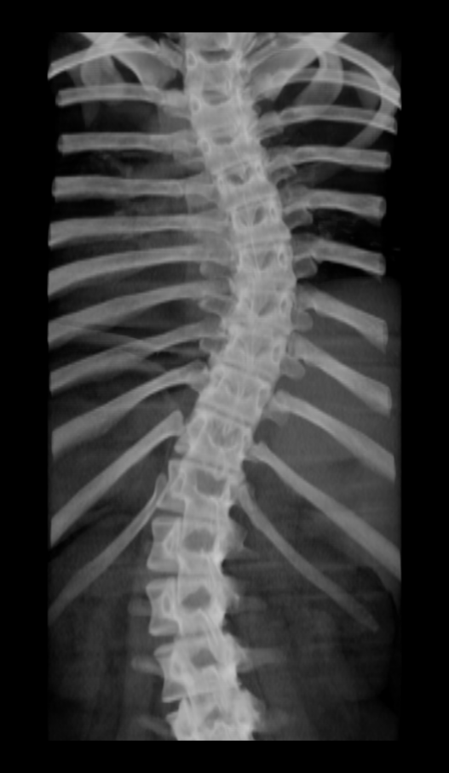
Introduction - Assessment
Gold-standard assessment method is X-ray imaging
Cobb angle is measured
Quantifies severity of scoliosis

Slide 4
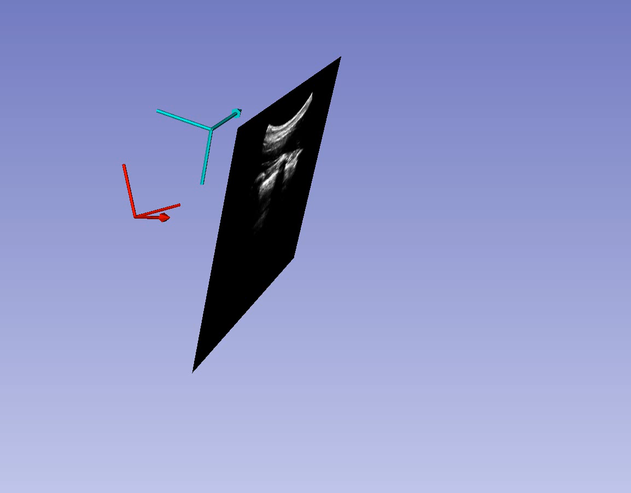
Introduction – Tracked Ultrasound
Motivated by X-ray health risks
Ungi et al. [1] investigated sagittal snapshots
Cheung et al. [2] and Wang et al. [3] used axial scans

Slide 5
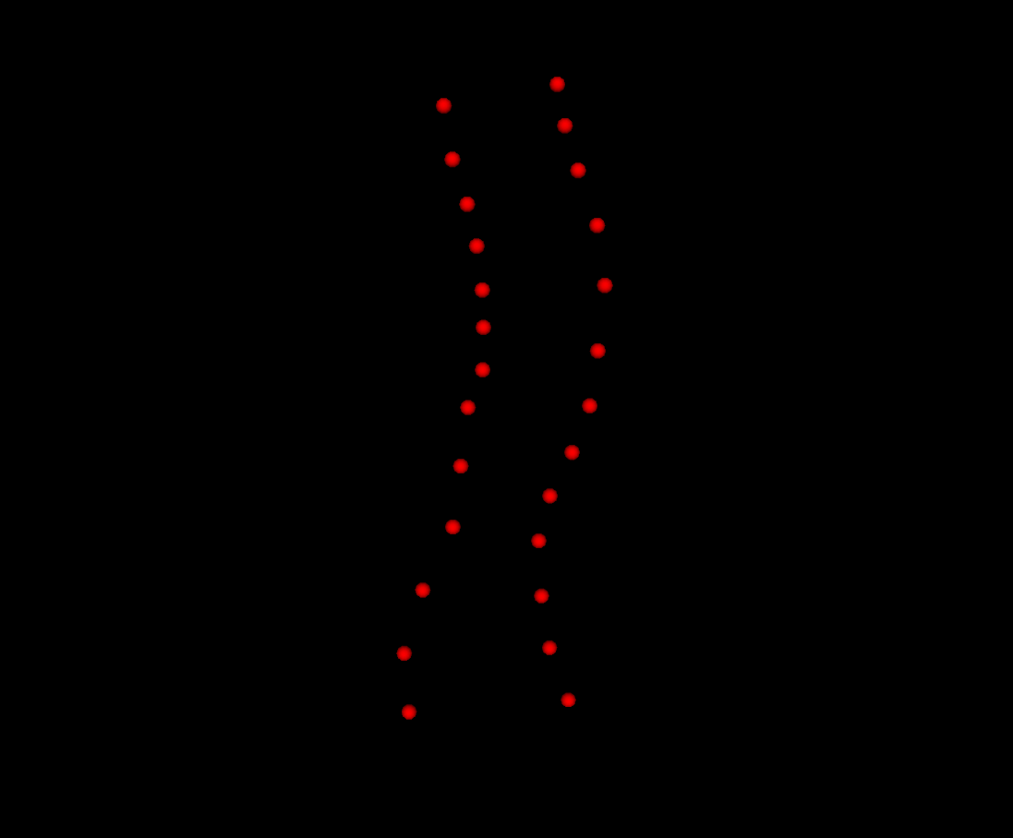
Introduction – Tracked Ultrasound
Tracking info with images allow landmark location
Curvature extracted from landmarks

Slide 6
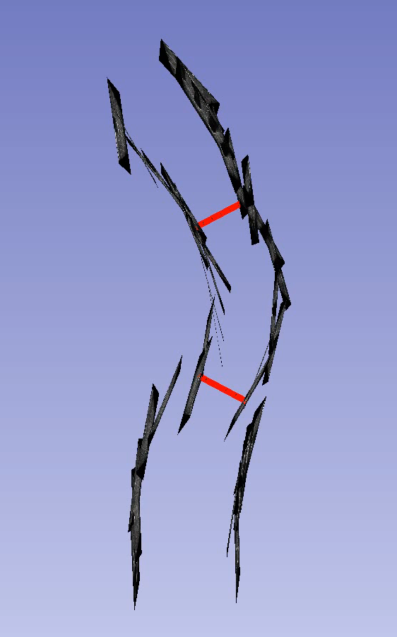
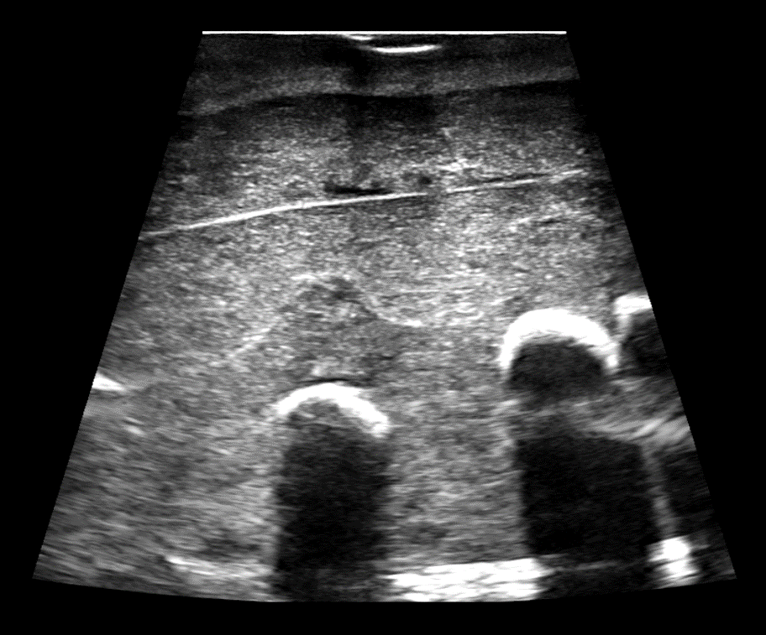
Problem Description
Ultrasound methods do not rely on familiar visualizations
Invisible bone
Visible bone
Shadow

Slide 7
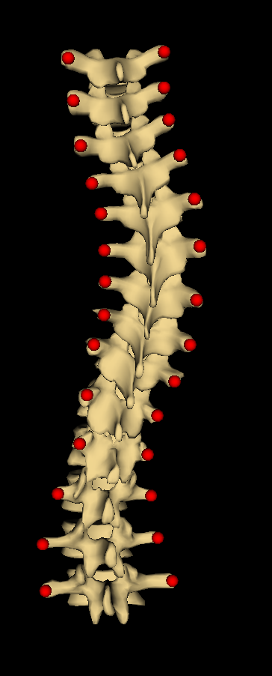
Objective
Create surface visualizations of scoliotic spines from transverse process locations

Slide 8
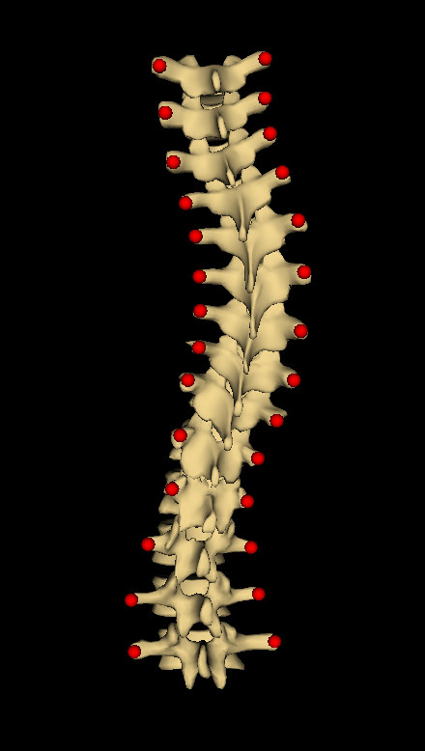
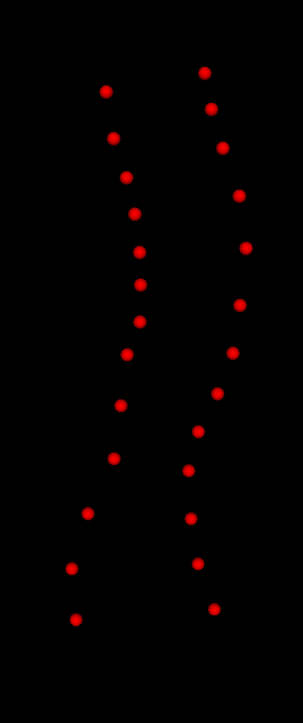
Contribution
A method for warping a healthy-shaped model to patients’ transverse processes

Slide 9
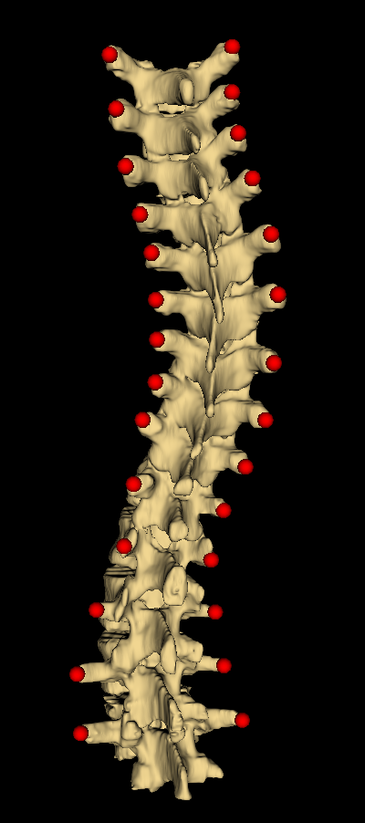
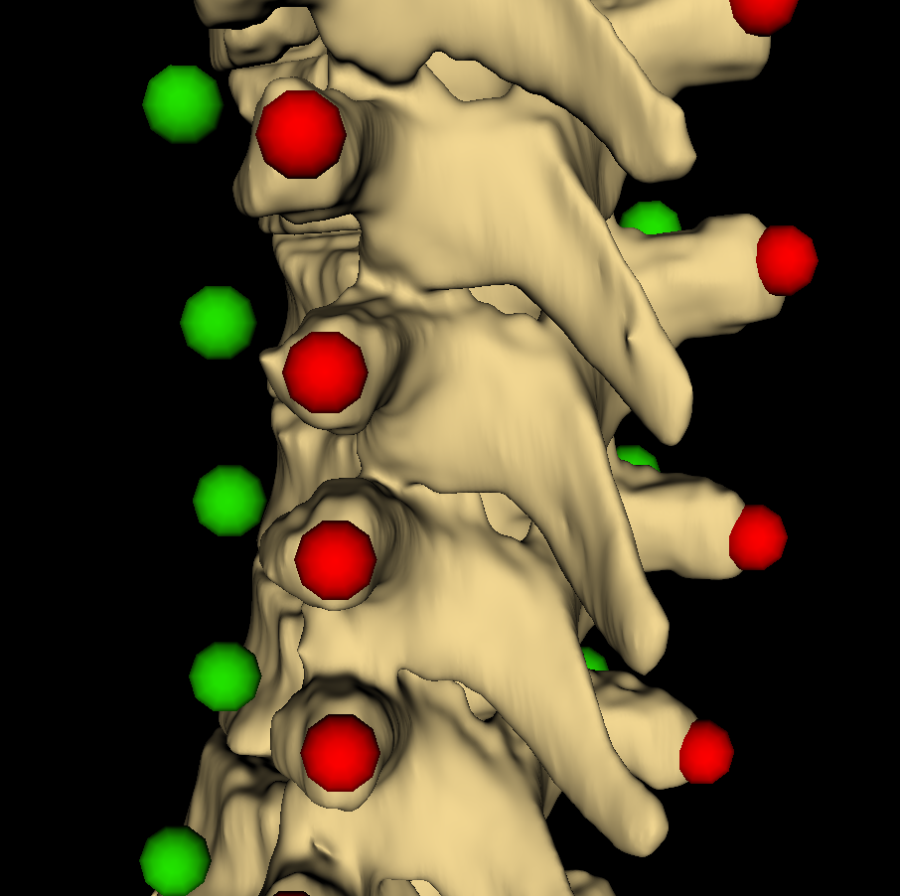
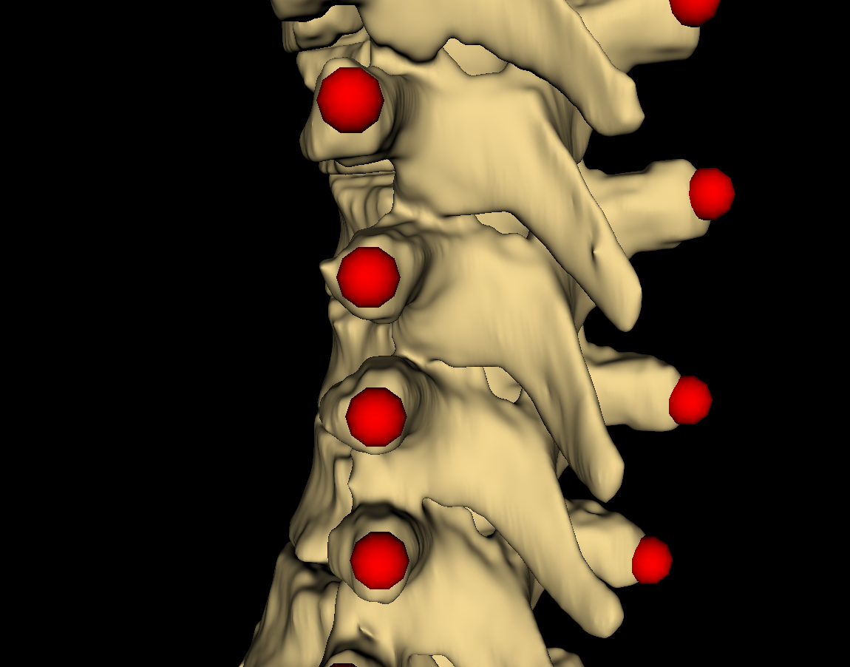
Methods
Anchor point locations calculated from landmark locations
Anchor points offset towards anterior anatomy of vertebrae from landmarks

Slide 10
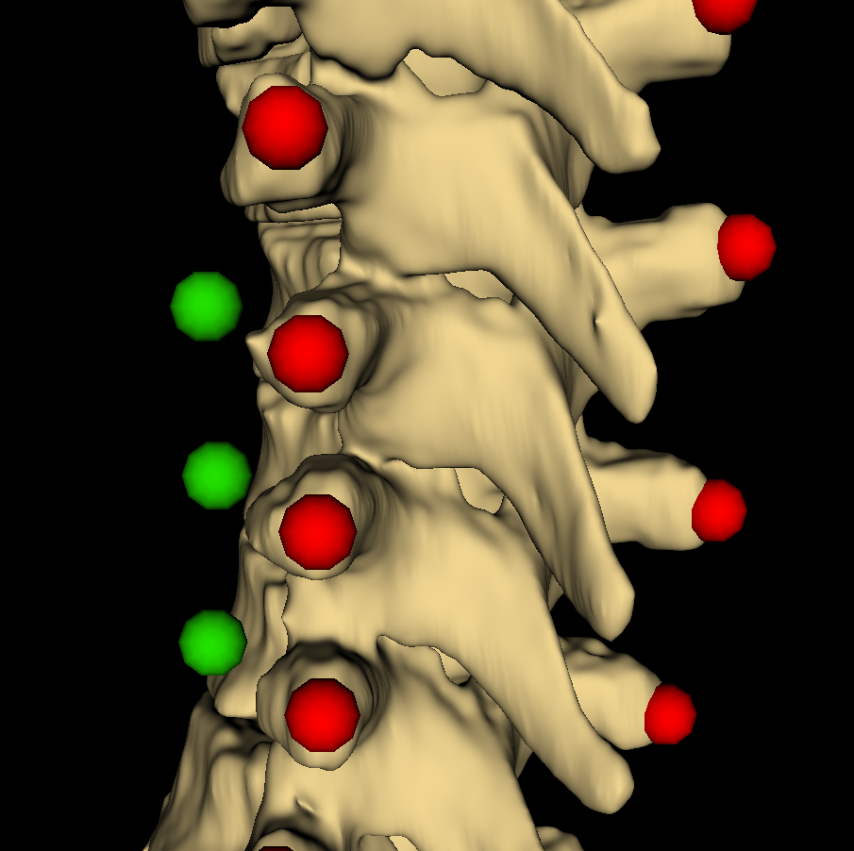
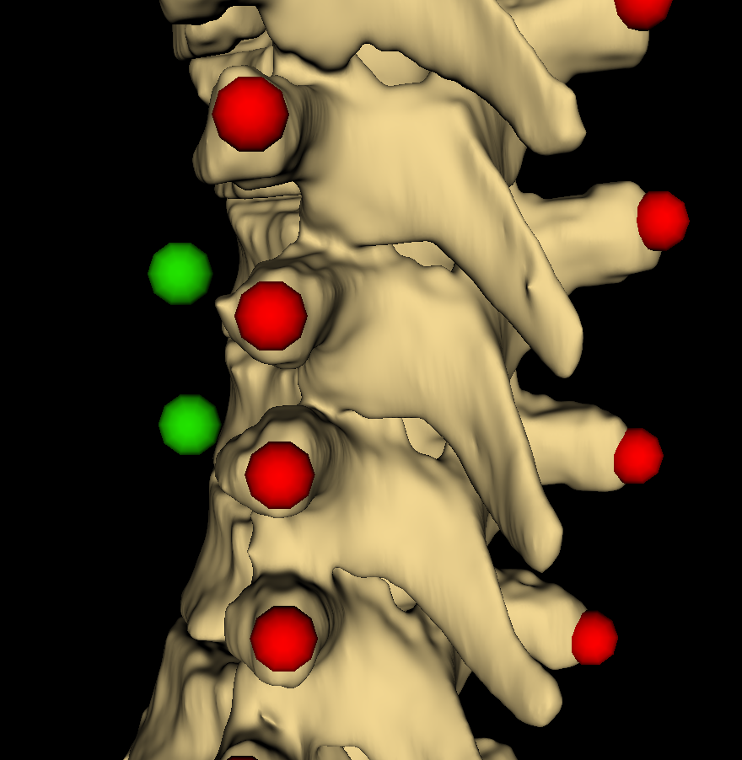
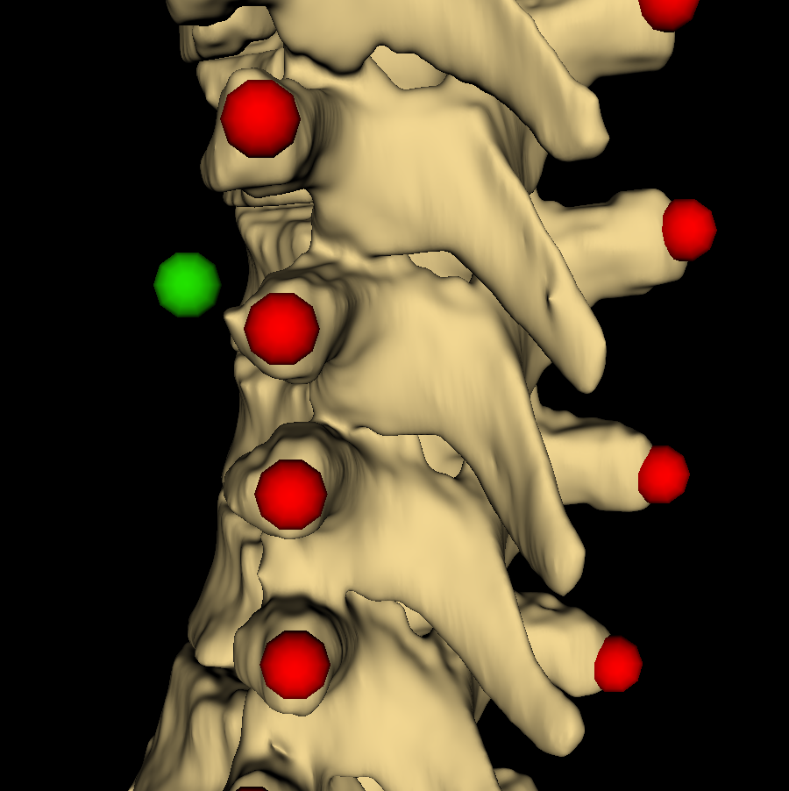
Methods
Directions of offsets determined from local inter-landmark geometry
Cross product of axial and lateral vectors point in desired direction

Slide 11
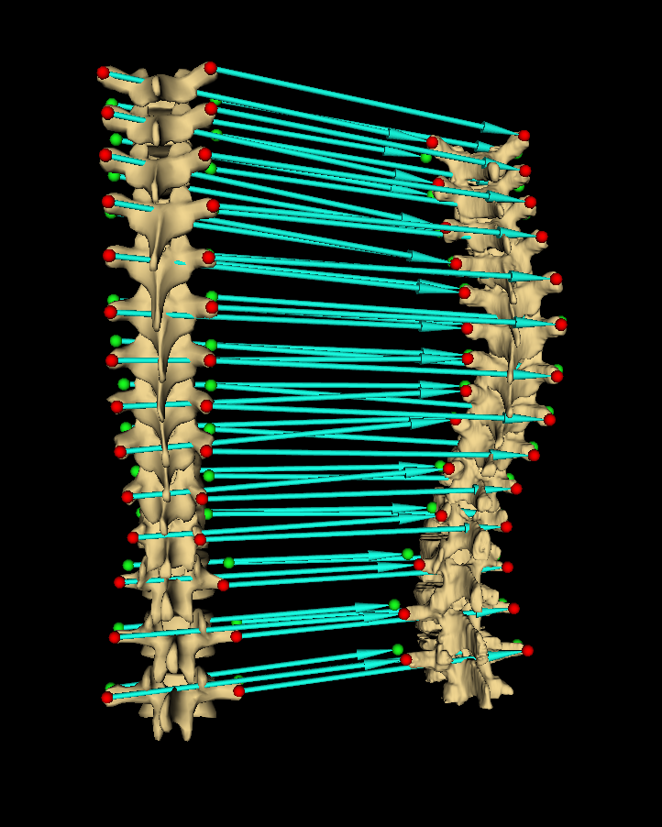
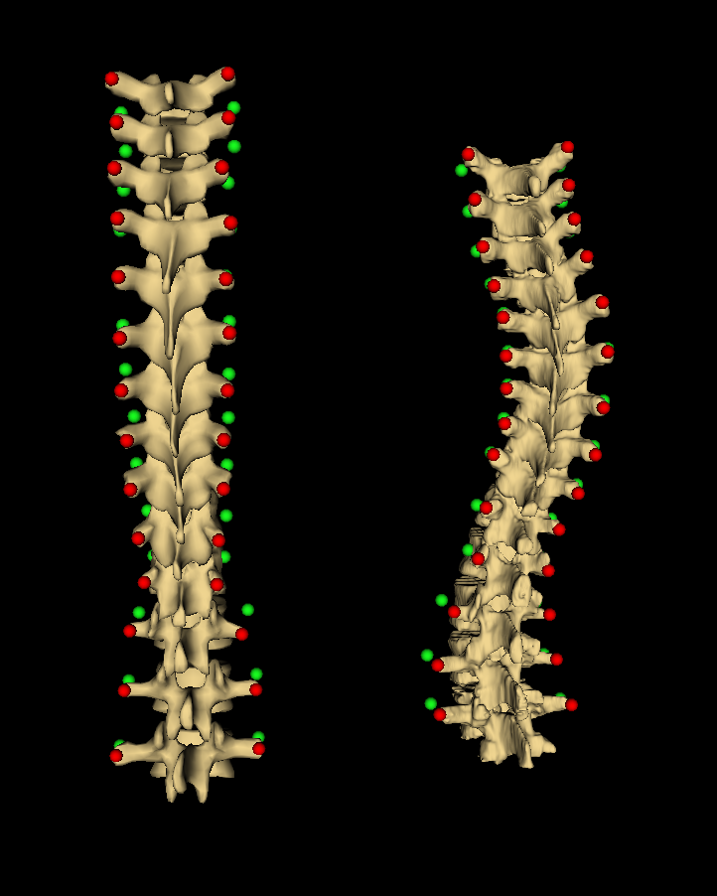
Methods
Landmark registration computes transforms which displace model points to patient points

Slide 12
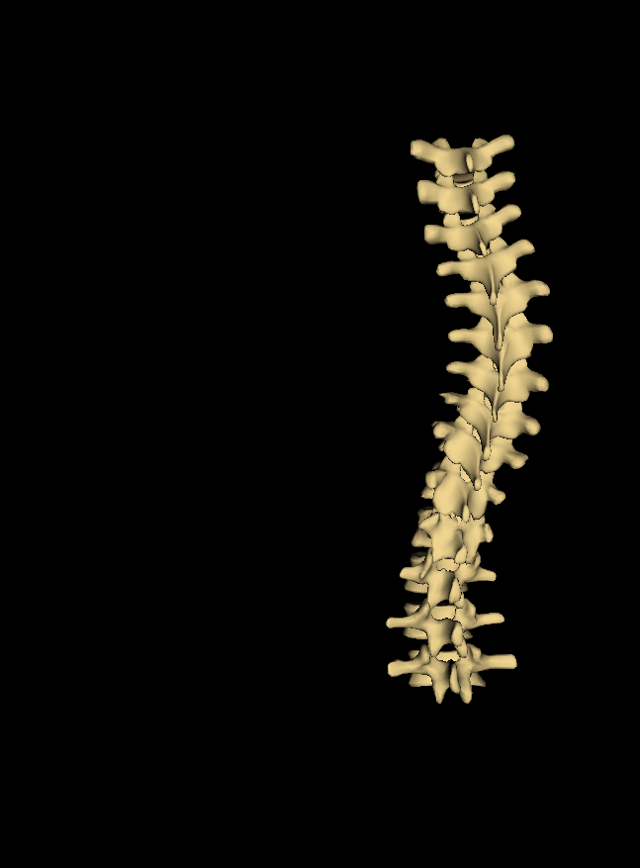
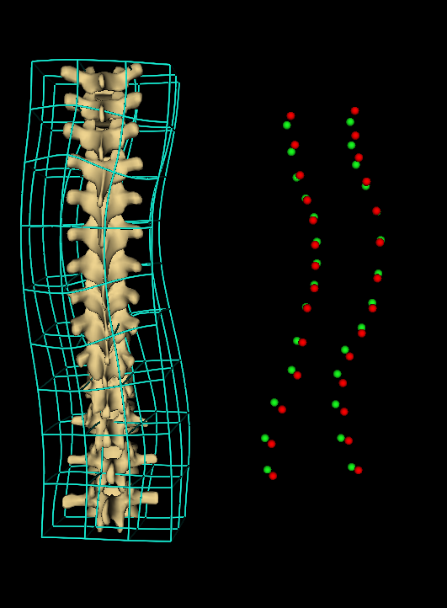
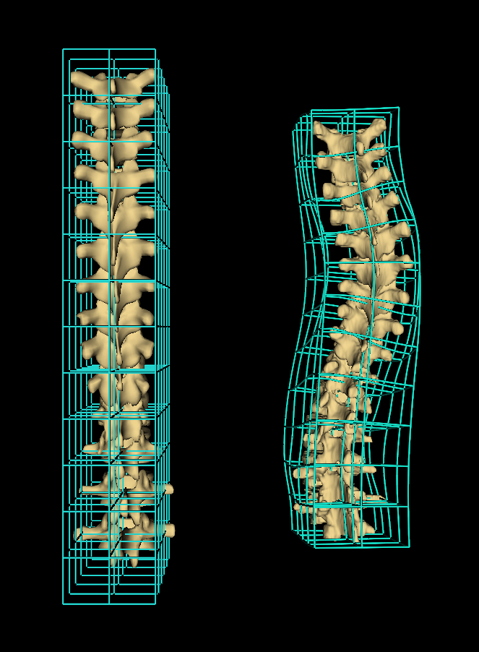
Methods
Thin-plate spline interpolates transforms, producing displacement field
Field is applied over model, warping it to patient anatomy

Slide 13
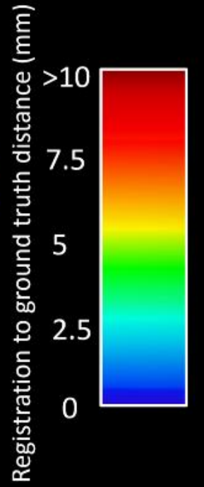
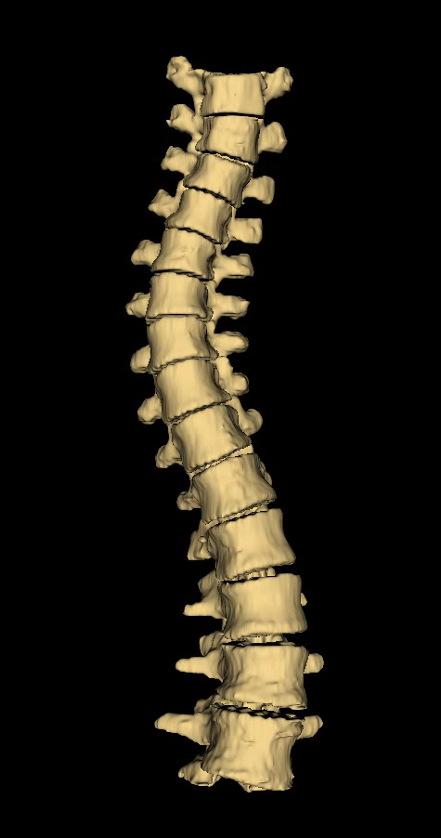
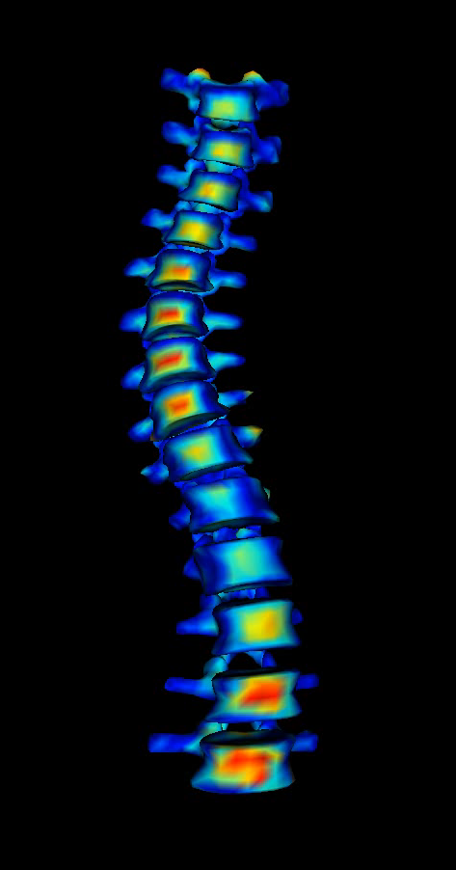
Results
Ground-truth
Visualization
Average Hausdorff distance: 2.8mm
Maximum Hausdorff distance: 20.0mm

Slide 14
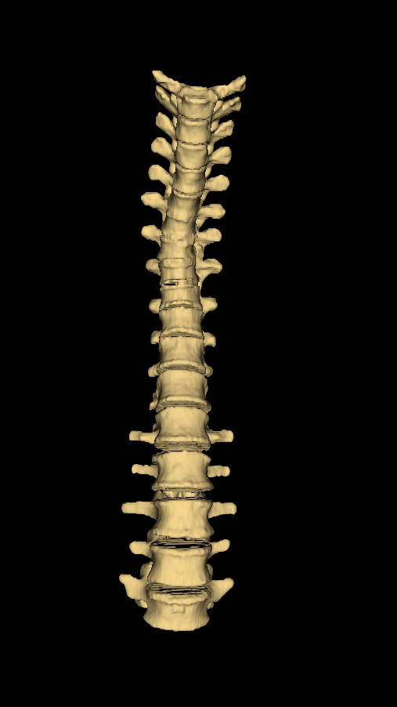
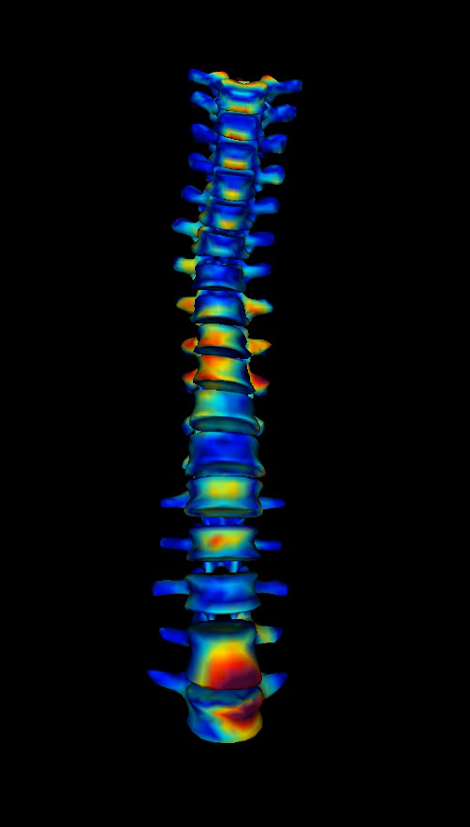
Results
Ground-truth
Visualization
Average Hausdorff distance: 2.3mm
Maximum Hausdorff distance: 24.0mm

Slide 15
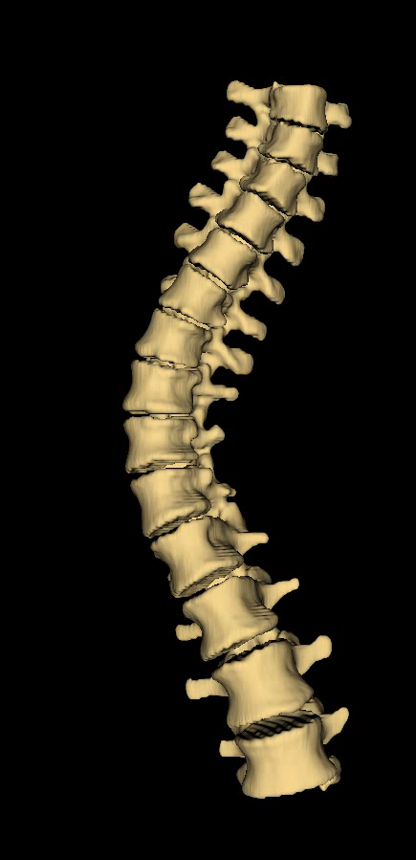
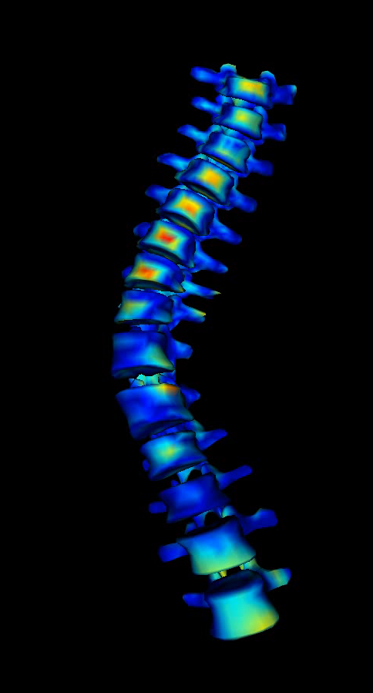
Results
Ground-truth
Visualization
Average Hausdorff distance: 2.4mm
Maximum Hausdorff distance: 17.7mm

Slide 16
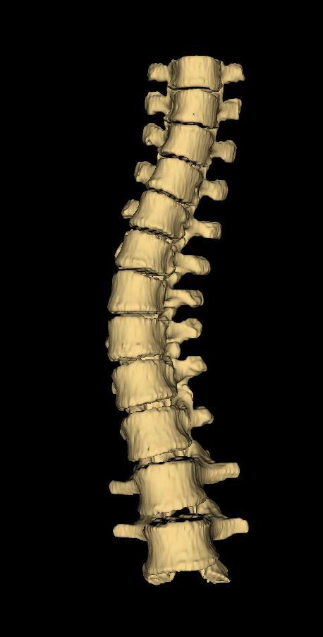
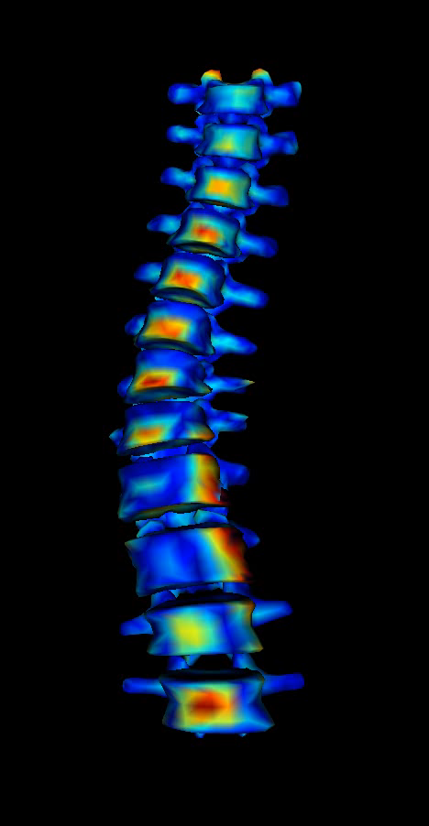
Results
Ground-truth
Visualization
Average Hausdorff distance: 2.9mm
Maximum Hausdorff distance: 18.1mm

Slide 17
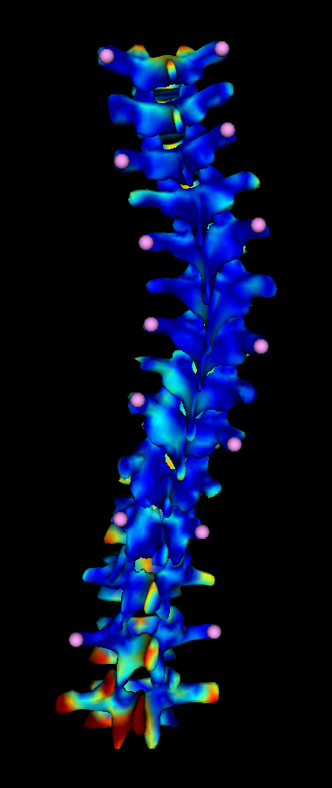
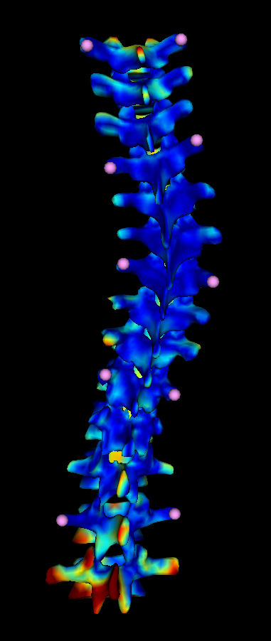
Conclusions
Method produces informative visualizations
Validate with landmarks from ultrasound
Investigate robustness
1/2
1/3

Slide 18
Thank you! Questions?

Slide 19
References
Ungi T, King F, Kempston M, Keri Z, Lasso A, Mousavi P, Rudan J, Borschneck DP, Fichtinger G. “Spinal curvature measurement by tracked ultrasound snapshots”. Ultrasound in Medicine and Biology. 2014 Feb; 40(2):447-54.
Cheung CW, Zhou GQ, Law SY, Mak TM, Lai KL, Zheng YP. “Ultrasound Volume Projection Imaging for Assessment of Scoliosis”. IEEE Trans Med Imaging. 2015 Aug; 34(8):1760-8.
Wang Q, Li M, Lou EHM, Wong MS. “Reliability and Validity Study of Clinical Ultrasound Imaging on Lateral Curvature of Adolescent Idiopathic Scoliosis”. PLOS ONE. 2015 Aug; 10(8):1-16.

